Slide 1
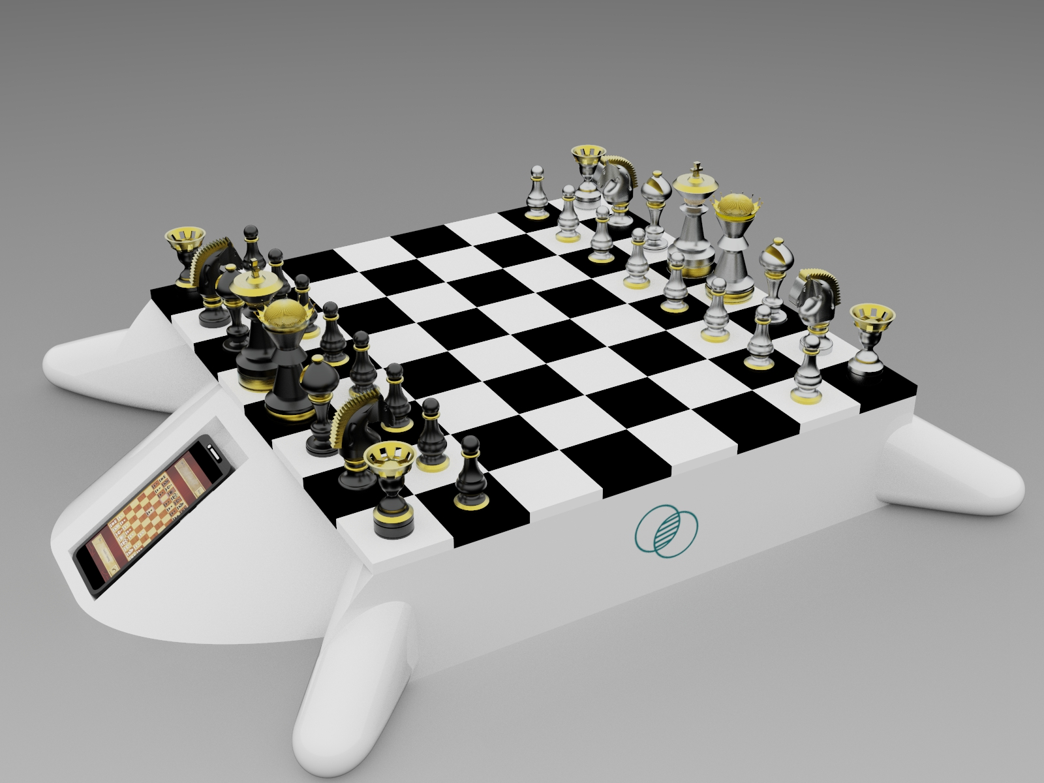
Single Player Chess
Designed a digital chess framework which redefines the experience of playing single-player chess

Slide 2
The phone in which we are playing chess with an online opponent is connected to the chessboard. The chessboard tiles synchronize with the online chess application which would in turn light up the corresponding tiles of the board.
This would make it much more exciting to play single-player chess!

Slide 3
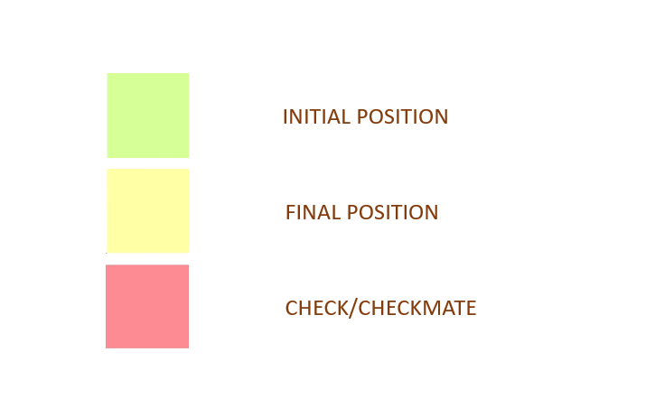
When we are making our first move by moving the white pawn, its initial position will be light green in color and its final position will be yellow in color. This change in the position of the chess piece is interpreted by the touch sensor on the chess board and the white pawn plays its move in the online chess game.

Slide 4
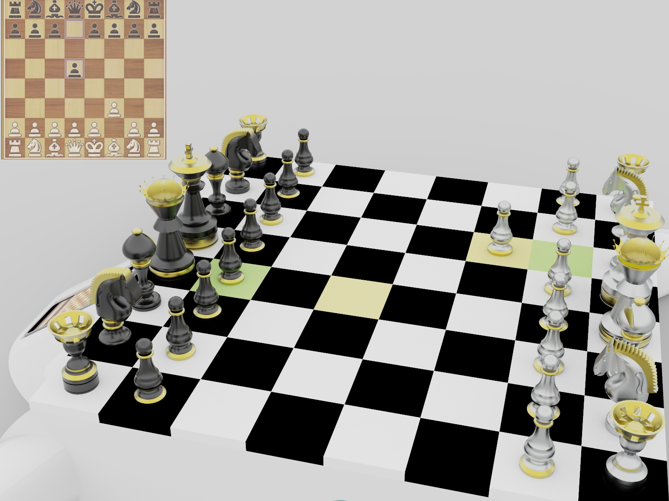

Slide 5
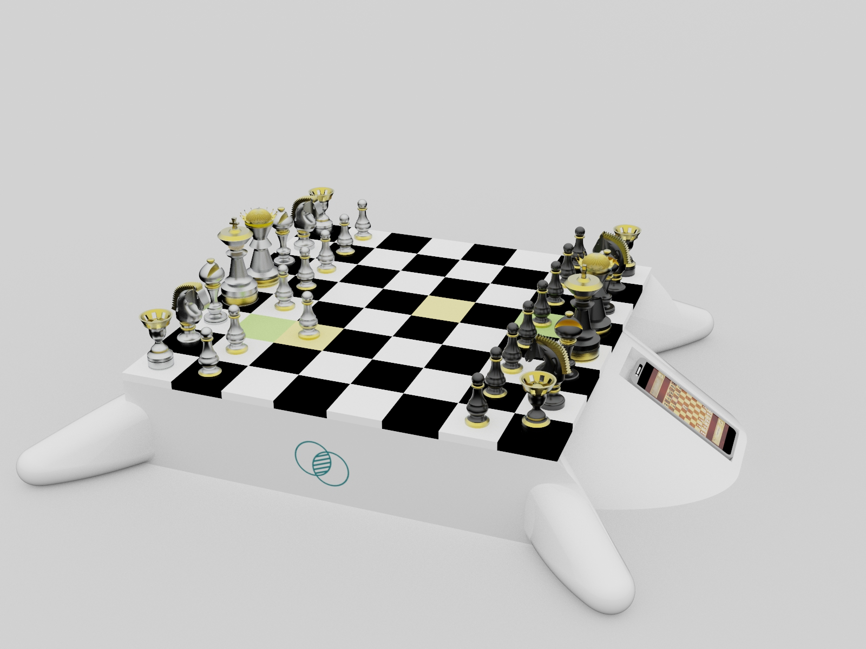
When the opponent in the online chess game moves their pawn, the tile in which that particular pawn is placed gets highlighted with a light green color and its final tile position is indicated by a yellow color. Then we play our next move after placing our opponent’s piece in the indicated position.

Slide 6
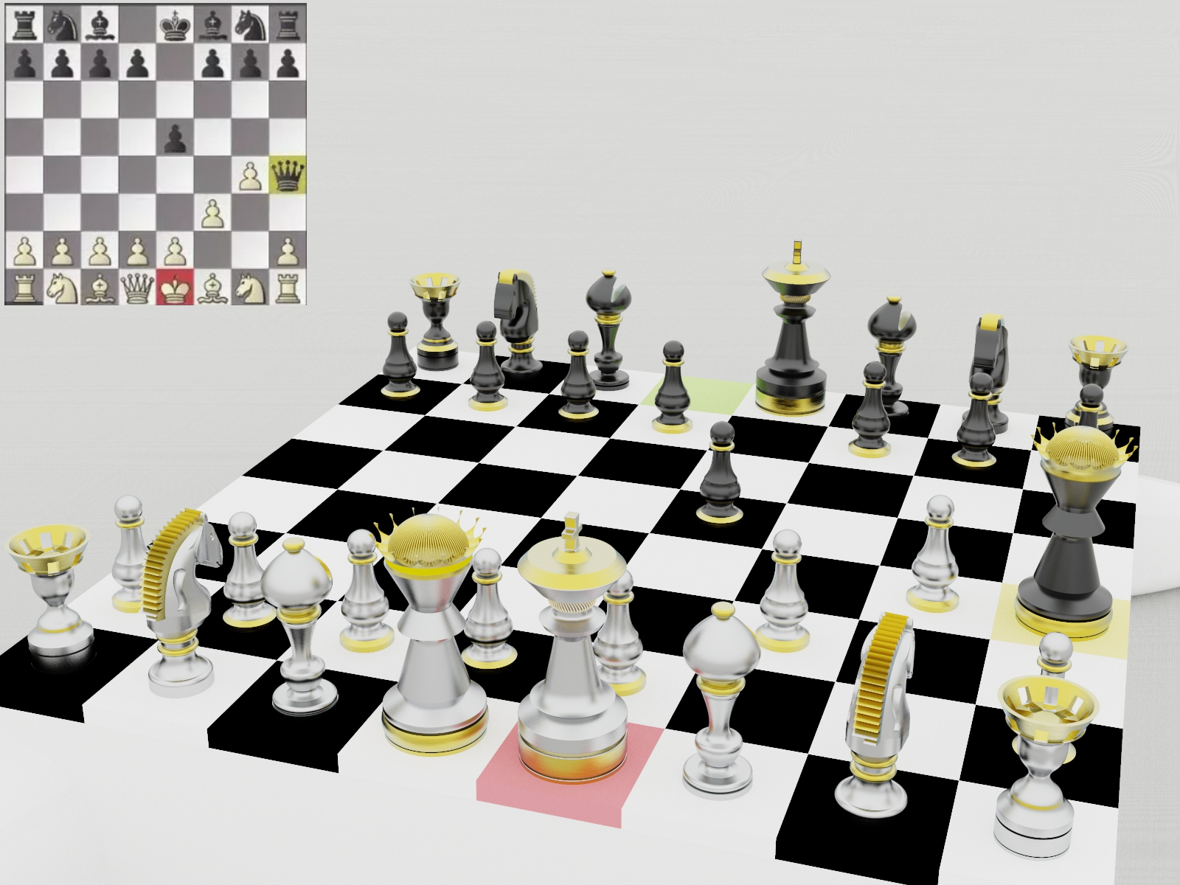
In case when the king is in check or gets checkmated, the tile gets highlighted with red in color

Slide 7
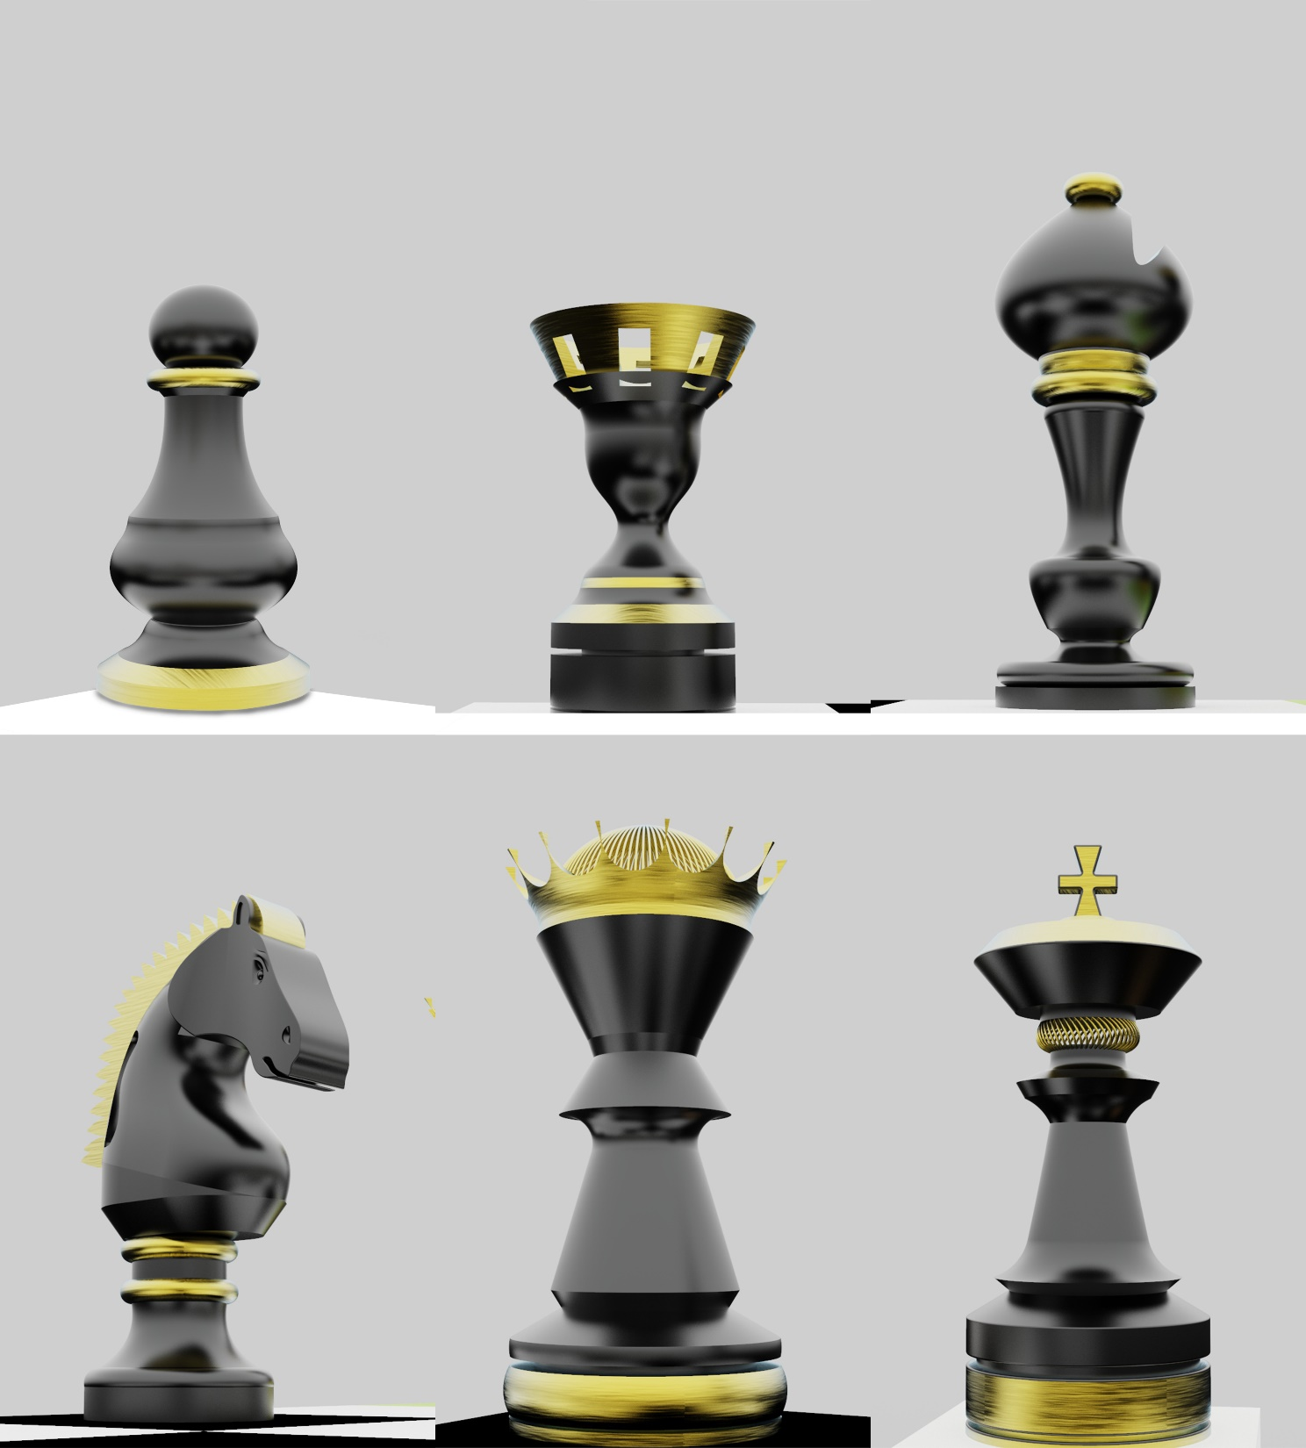

Slide 8
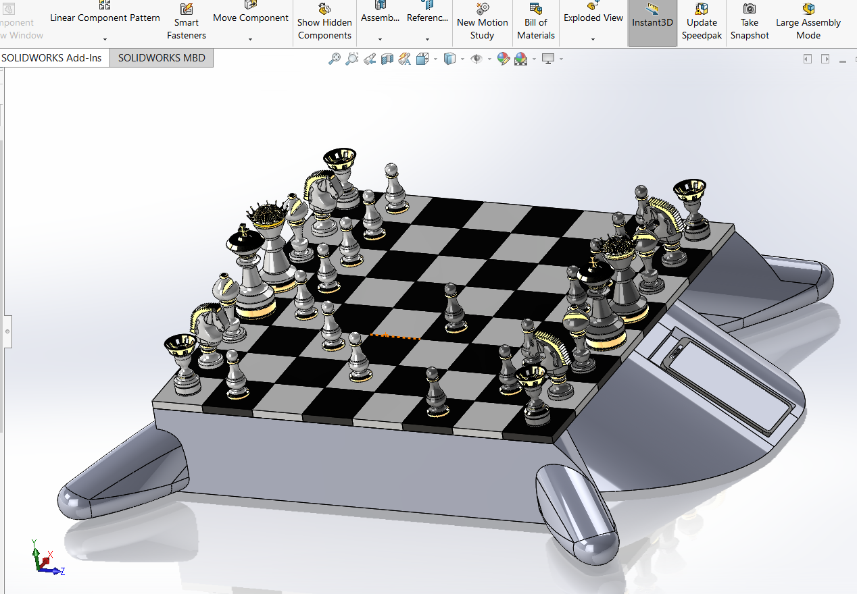
Designed in SolidWorks

Slide 9
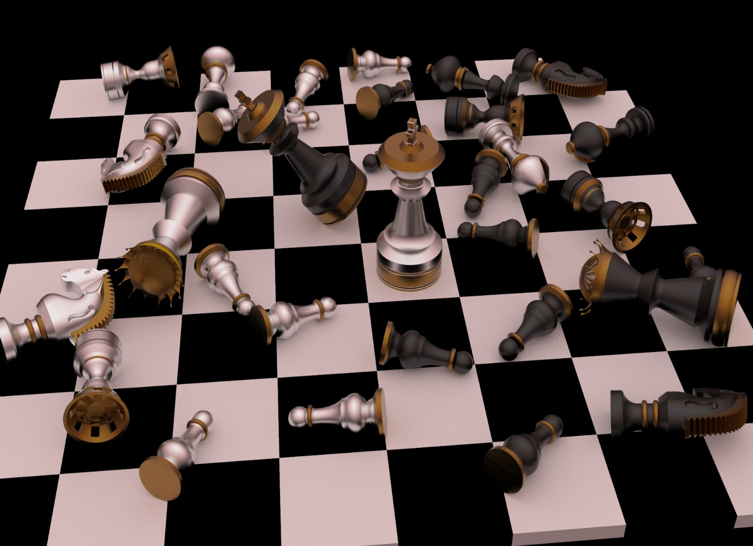
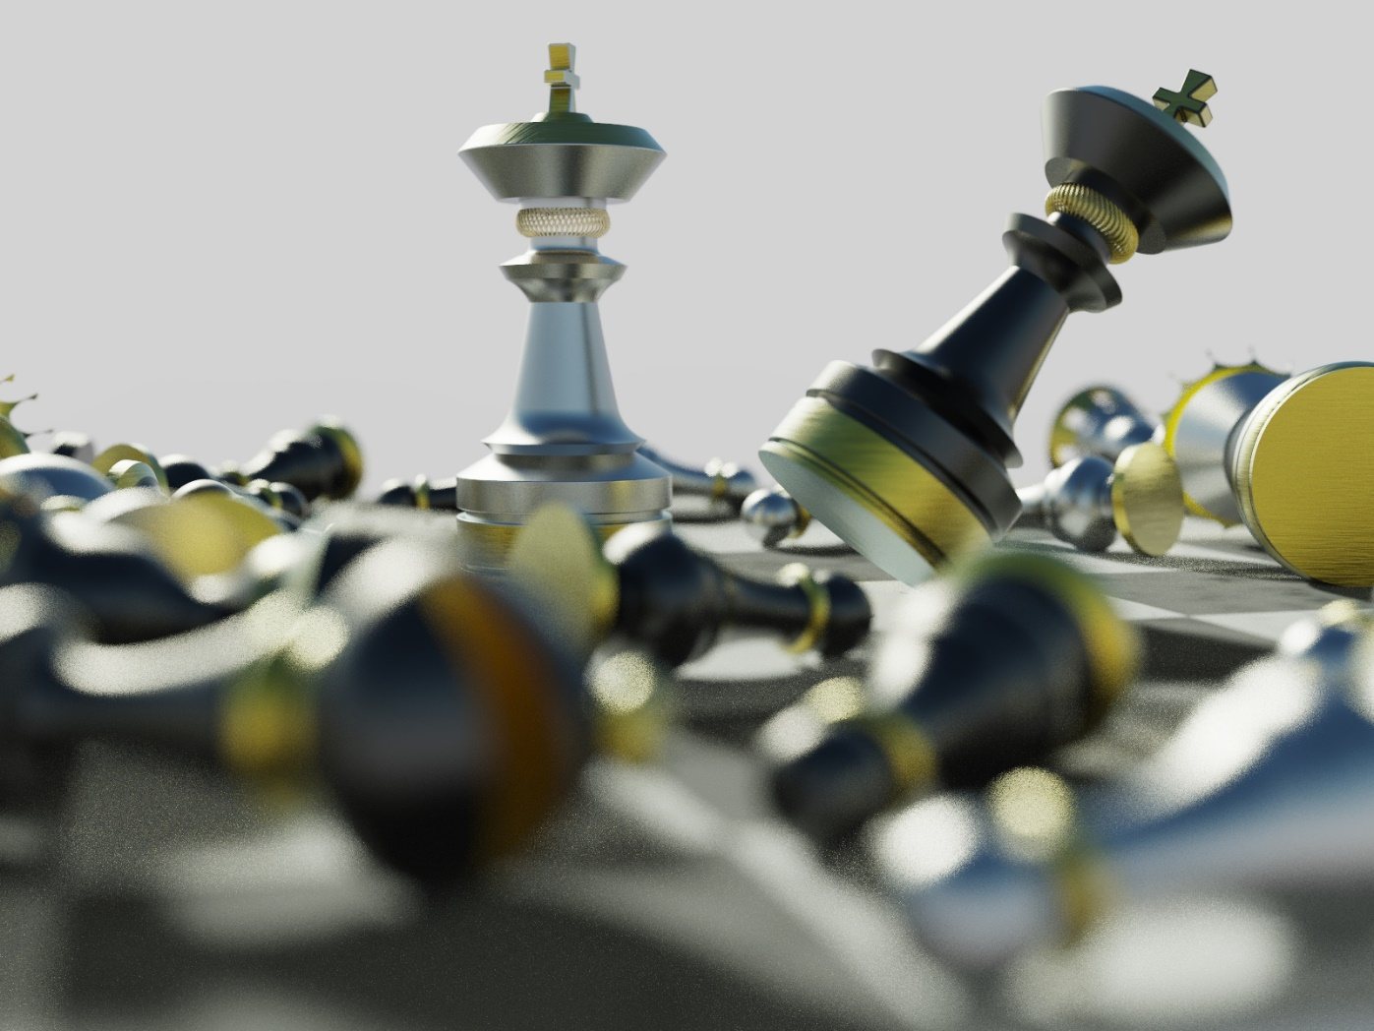
Rendered in Keyshot

